Slide 1
Big Data Assignment - I
Usage of Big Data technologies in combating COVID-19 pandemic
By – Team A
Andrew, Cyril, George, Shanaz, Tanu
1
2
3
3
3
Notes:
Upstream delegation

Slide 2
Business Case
Problem Statement
The risk of a third pandemic wave in Indian sub-continent has risen as Covid-19 cases are rising in several states. Indian Union government is closely monitoring and debating on the effectiveness of lockdowns
Goal
To analyze the effectiveness of lockdowns and share the recommendations on extending lockdown in Indian States
Developing lockdown strategies based on data, can help avoid strangling the economy with complete lockdowns and avoid sudden spike in cases due to upcoming festivals and complement the efforts to breaking the chain of transmission
Notes:
Upstream delegation

Slide 3
Business Case
Strategy
Analyze the impact of lockdown imposed in various countries due to COVID-19
Compare the countries which imposed the complete lockdown with restricted lockdown and analyze the variation of COVID-19 cases
Observe trend in US with actual lockdown scenario and a pre-emptive lockdown hypothesis
Analyze should the lock down be extended in India, Fetch the list of India States where the lockdown must be continued.
Notes:
Upstream delegation

Slide 4
Technologies Used (What, Why, How)
Hadoop is a reliable, distributed, and scalable distributed data processing platform for storing and analysing vast amounts of data.
The lure of Hadoop is its ability to run on cheap commodity hardware, while its competitors may need expensive hardware to do the same job.
We can get structured or unstructured data sets that are rapidly generated and transmitted from a wide variety of sources.
Using this Technology we can track the virus on a global basis continuously and to create innovation in the medical field.
It’s also open-source.
this technology provides data to undertake analysis of the disease transmission, movement, and health monitoring and prevention system.
It can help to forecast the impact of COVID-19 in a particular area and the whole population.
Notes:
Upstream delegation

Slide 5
Significance
Big Data in COVID-19 pandemic
S. No. | Applications | Description
1. | Identification of infected cases | this technology helps in identification of the infected cases and undertake further analysis of the level of risks
2. | Travel history | Helps to identify people who may be in contact with the infected patient of this virus
3. | Fever symptoms | identify the suspicious cases
4. | Identification of the virus at an early stage | Quickly helps to identify the infected patient at an early stage
5. | Identification and analysis of fast-moving disease | Helps to effectively analyse the fast-moving disease efficiently
6. | Information during lockdown | Track and monitor the movement of people and health management
7. | People entered or leaving the affected area | quickly identify the chances of the virus in those peoples
8. | Faster development of medical treatments | helps in gaining a giving advantage over newer pandemic/epidemic with previously analysed results
Notes:
Upstream delegation

Slide 6
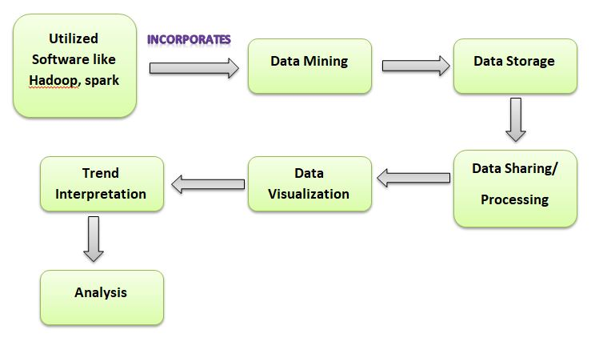
Implementation Approach
Notes:
Upstream delegation

Slide 7




Challenges
Privacy & Security
Data Accuracy
Data Sharing Protocol
Patient Data
Computational Limitations
Ability to Acquire Data Quickly
Notes:
Upstream delegation

Slide 8

Expected Benefits
Strategic planning
The tracking of Infected Individuals
The provision of advice to concerned and possibly infected individuals
Preparations for influx of patients
Notes:
Upstream delegation

Slide 9
Project Status Summary
Problem Defined
Project Feasibility Analysis
Project Schedule Preparation
Project Kickoff
Notes:
Upstream delegation

